Slide 1


SAVEETHA SCHOOL OF ENGINEERING
SAVEETHA INSTITUTE OF MEDICAL AND TECHNICAL SCIENCES
CSA0697 DESIGN AND ANALYSIS OF ALGORITHM FOR LOWER BOUND THEORY
TOPIC: Algorithmic in N-Queens with Backtracking
FACULTY NAME: Dr. Gnana Soundari
By,
NAME :C. Harsha Vardhan Reddy
REG.NO:192210375

Slide 2
ABSTRACT
The N-Queens problem is a classic combinatorial problem that involves placing N queens on an N×N chessboard such that no two queens threaten each other.
This problem can be solved using various techniques, and one of the most efficient approaches is through backtracking.
Backtracking is an algorithmic paradigm that builds the solution incrementally, abandoning a solution path as soon as it determines that it cannot lead to a valid solution.
n the N-Queens problem, the algorithm places queens one by one in different columns, starting from the leftmost column.
For each column, the algorithm checks if placing a queen in a particular row is safe by ensuring that no other queens threaten the position horizontally, vertically, or diagonally.

Slide 3
N-Queens:
The N-Queens problem is a classic combinatorial problem in computer science and mathematics.
It involves placing N queens on an N×N chessboard such that no two queens can attack each other.
The goal is to find all possible configurations where the queens can be placed under these constraints.
Back Tracking:
Backtracking is an algorithmic technique used to solve problems incrementally by trying out partial solutions and then abandoning them if they don't lead to a valid solution.

Slide 4
INTRODUCTION
The N-Queens problem is a well-known challenge in the field of combinatorial optimization and algorithm design.
The task is to place N queens on an N×N chessboard in such a way that no two queens can attack each other.
This means that no two queens should share the same row, column, or diagonal.
To solve the N-Queens problem efficiently, various techniques can be applied, including brute force and backtracking. Among these, backtracking stands out as a practical and effective method.
Backtracking is a depth-first search algorithm that incrementally builds the solution, testing each partial solution for feasibility.
If the current configuration leads to a conflict, the algorithm backtracks by removing the last placed queen and tries a different position. This process continues until a solution is found or all possible configurations are exhausted.

Slide 5
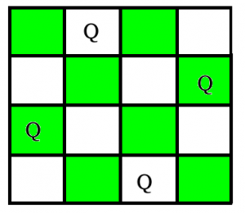
Conditions for N- Queens Backtracking:
Each queen must be placed in a unique row.
No two queens should be placed in the same column.
No two queens should be placed on the same diagonal
If at any row, no valid column can be found for placing the queen the algorithm backtracks to the previous row and tries a different column placement for the queen in that row.
This process continues until a solution is found or all possible configurations are exhausted.

Slide 6
PROBLEM STATEMENT
The N-Queens problem requires placing N queens on an N×N chessboard such that no two queens can attack each other.
The challenge lies in ensuring that no two queens occupy the same row, column, or diagonal, which are the three possible ways in which queens can threaten one another.
Accept a user input for the size of the chessboard, N.
Dynamically place N queens on an N×N chessboard in such a way that no two queens threaten each other.
Explore possible configurations using the backtracking technique, which recursively places queens and backtracks when conflicts arise.
Output one valid arrangement of queens on the chessboard, or indicate if no solution exists.

Slide 7
CODING:
bool solveNQUtil(int **board, int col, int N) {
if (col >= N)
return true;
for (int i = 0; i < N; i++) {
if (isSafe(board, i, col, N)) {
board[i][col] = 1;
if (solveNQUtil(board, col + 1, N))
return true;
board[i][col] = 0; // Remove queen
}
}
return false;
}
bool solveNQ(int N) {
int *board = (int *)malloc(N * sizeof(int *));
for (int i = 0; i < N; i++) {
board[i] = (int *)malloc(N * sizeof(int));
for (int j = 0; j < N; j++) {
board[i][j] = 0;
}
}
if (!solveNQUtil(board, 0, N)) {
printf("Solution does not exist\n");
return false;
}
#include <stdio.h>
#include <stdlib.h>
#include <stdbool.h>
void printSolution(int **board, int N) {
for (int i = 0; i < N; i++) {
for (int j = 0; j < N; j++) {
printf("%d ", board[i][j]);
}
printf("\n");
}
}
bool isSafe(int **board, int row, int col, int N) {
int i, j;
for (i = 0; i < col; i++)
if (board[row][i])
return false;
for (i = row, j = col; i >= 0 && j >= 0; i--, j--)
if (board[i][j])
return false; for (i = row, j = col; j >= 0 && i < N; i++, j--)
if (board[i][j])
return false;
return true;
}

Slide 8
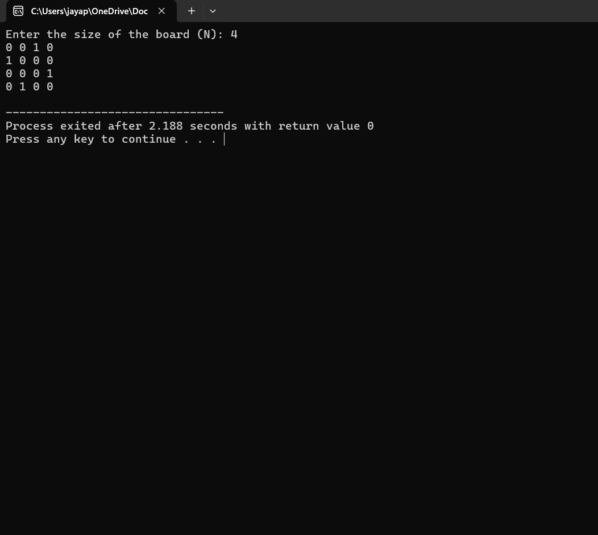
printSolution(board, N);
for (int i = 0; i < N; i++) {
free(board[i]);
}
free(board);
return true;
}
int main() {
char input[100];
printf("Enter the size of the board (N): ");
fgets(input, 100, stdin);
int N = atoi(input);
if (N < 4) {
printf("No solution exists for N less than 4.\n");
return 1;
}
solveNQ(N);
return 0;
}
OUTPUT:

Slide 9
CONCLUSION:
The N-Queens problem is a fundamental challenge in combinatorial optimization, demonstrating the complexities and nuances of constraint satisfaction.
The backtracking algorithm provides an effective method for solving this problem by incrementally placing queens on an N×N chessboard and using recursive exploration to ensure that no two queens threaten each other.
This C program implementation showcases how backtracking can be used to solve the N-Queens problem, dynamically adjusting to different board sizes based on user input.
By recursively placing queens and backtracking when conflicts arise, the algorithm efficiently navigates the search space and finds a valid solution if one exists.
The ability to handle various board sizes and the clear demonstration of recursive problem-solving techniques highlight the robustness of backtracking for combinatorial problems.

Slide 10


